Slide 1

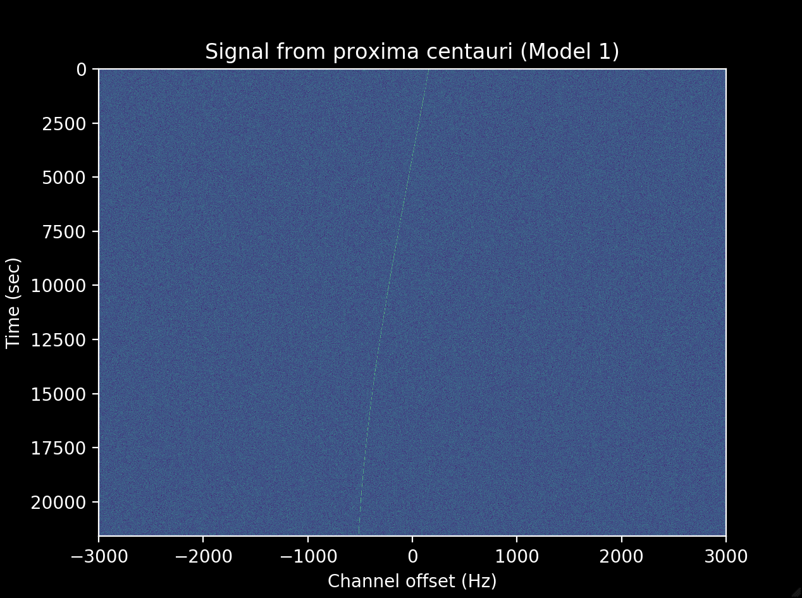
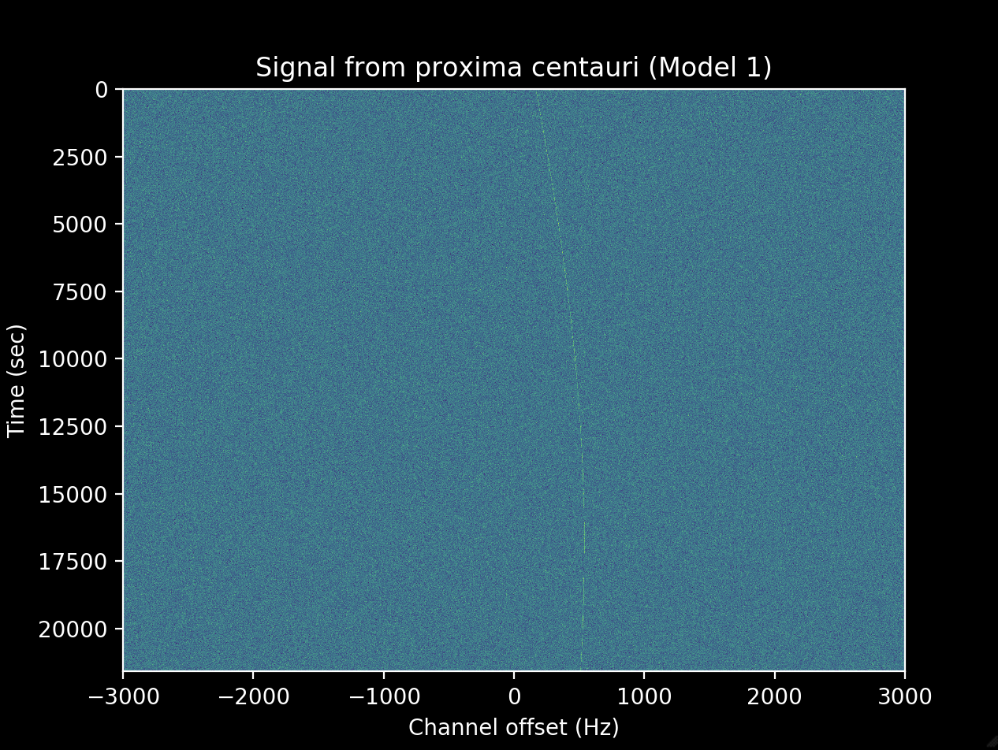
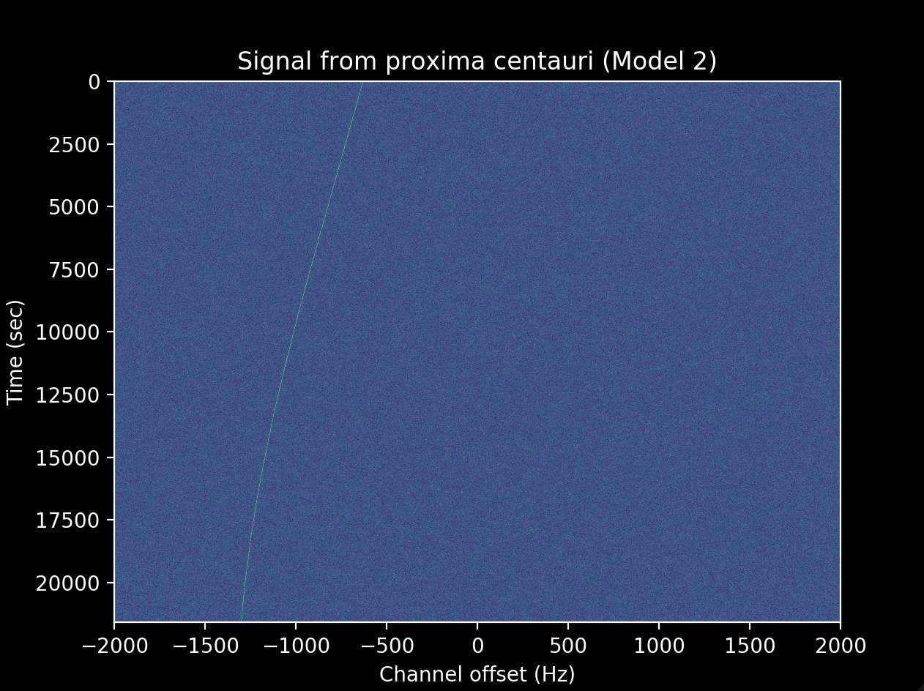
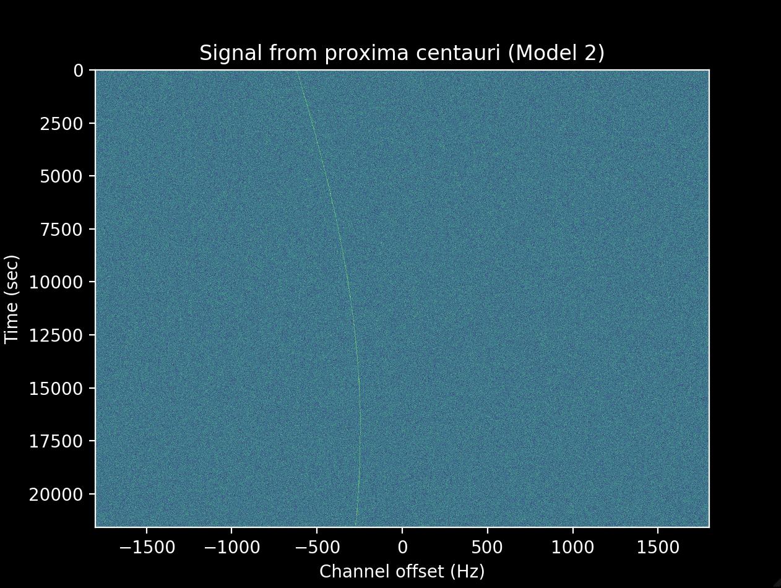
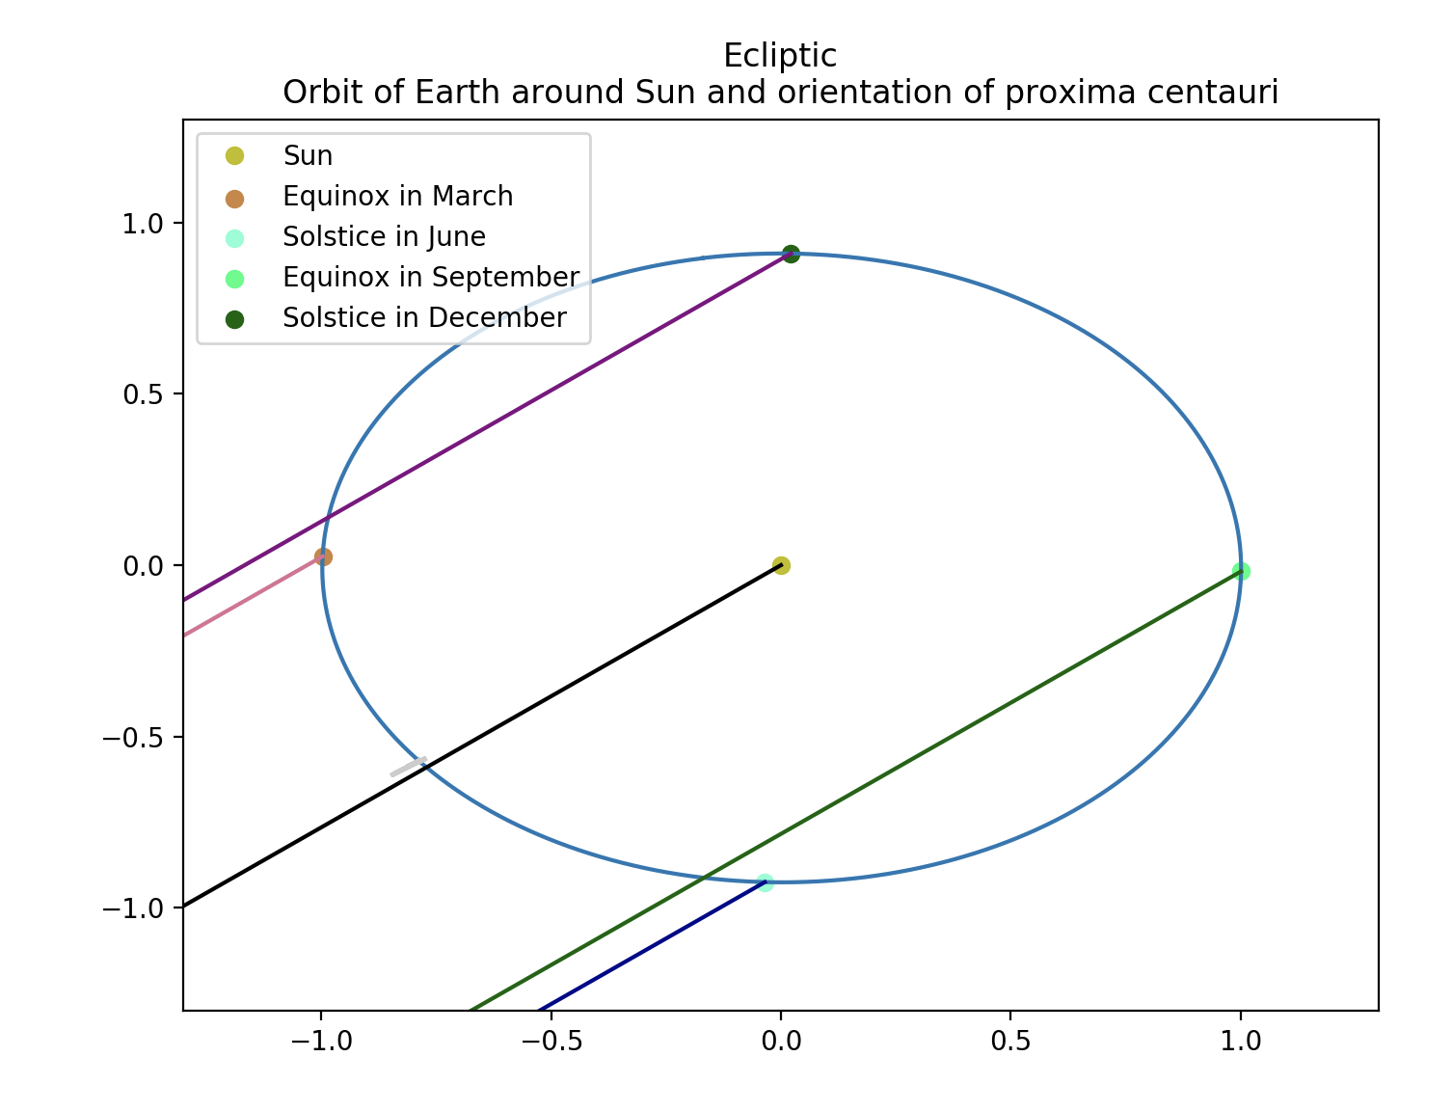
Drift Rate Analysis of Detected Signals of Interest Anna Gagnebin and Dr. David DeBoer Berkeley SETI Research Center
Background:
This project builds upon a set of code written by Dr. David DeBoer to analyze the validity of a signal of interest that seemed to originate from Proxima Centauri.
Causes of Drift
Movement of the solar system barycenter, geocenter, and the rotation of the Earth at the location of the observer
Rotation of the signal source around its star
Radio interference from phones, radios, or other transmitters in moving cars, bicycles, planes, satellites, or probes
Electronic oscillations in Earth-bound transmitters
Introduction
Models and Assumptions
Model 1:
The signal was sent intentionally to our solar system, so the drift due to the motion of the barycenter as well as the motion of the source has already been accounted for
Model 2:
The signal was intentionally sent to the Earth, so the drift due to the motion of the source as well as our barycenter and geocenter has already been accounted for
Goals
To help develop a comprehensive set of code that can be used to analyze potential signals of interest.
To develop a user-friendly Jupyter Notebook to help visualize the direction and drift rates of a potential signal from any star.
References:
Taylor et al. (2018). Spectral kurtosis-based RFI mitigation For chime. Journal of Astronomical Instrumentation, 08(01). https://doi.org/10.1142/S225117171940004X
Thompson, N.C. (2014). RFI mitigation in radio astronomy [Master’s thesis, Stellenbosch University]. https://core.ac.uk/download/pdf/37421941.pdf
Price et al. (2020). The Breakthrough Listen Search for Intelligent Life: Observations of 1327 Nearby Stars over 1.10-3.45 GHz. The Astronomical Journal, 159(3). https://doi.org/10.3847/1538-3881/ab65f1
Work done by Sheikh et al. and Smith et al.
Funding:
Funding for this project is provided by the National Science Foundation and Breakthrough Initiatives
Notes:
Given rough code that was created to analyze the signal from blc1, which was a signal that came from Proxima Centauri
Goal of the code is to visually determine whether the drift rate of the signal of interest is consistent with the frequency drift from the earth or man-made RFI
2 things that make a signal interesting:
It is observed only when the telescope is pointed at a specific point on the sky but is not present when pointing at a different point on the sky
SETI search generally uses an on-off search cadence where it spends equal time looking at a specific star, and a point on the sky far enough away that any signal would no longer show up, sometimes, the telescope is being used for a different astronomy purpose, so it was an on-off cadence, but without equal times
It doesn’t seem to match the drift of any known astrophysical phenomenon at the frequency of the signal
Frequency Shift- Change in frequency of a signal in time ($Hz/s$) due to the relative velocities of both the source of the signal and the Earth
Frequency Drift- Change in velocity of signal in time ($Hz/s^{2}$) due to the movement of the signal and the Earth
Causes of drift- the first two are what can cause the drift of an actual signal of interest. Last 2 are what could make an Earth-bound or other manmade signal appear to have a drift rate not coinciding with a known astrophysical property. Telescopes are often radio silent zones, so you have to turn off wifi, Bluetooth, data, cell, etc so that there doesn’t appear to be a signal of interest where it’s really just a cellphone
Proxima centauri part of the Alpha Centauri system, which is the closest star system our solar system
Jupyter notebook – simulate waterfall plots of a signal from any star for two different models
There are two different assumptions that we’re working with when making the simulated waterfall plots (on poster), neither one correct for the drift from Parkes, since whoever sent the signal most likely wouldn’t have an exact position where they’re sending it
Next steps to finish Jupyter notebook as well as code set for future use in SETI search
Funding from NSF and BL

